Slide 1
Results of the week
Daniil Terebilenko
Junior DevOps Engineer

Slide 2

AWS Skillbuilder
AWS Cloud Practitioner Essentials
Introduction to AWS Identity and Access Management (IAM)
Introduction to AWS Billing and Cost Management
Introduction to AWS Auto Scaling
Introduction to Containers
Introduction to Amazon Virtual Private Cloud (VPC)

Slide 3
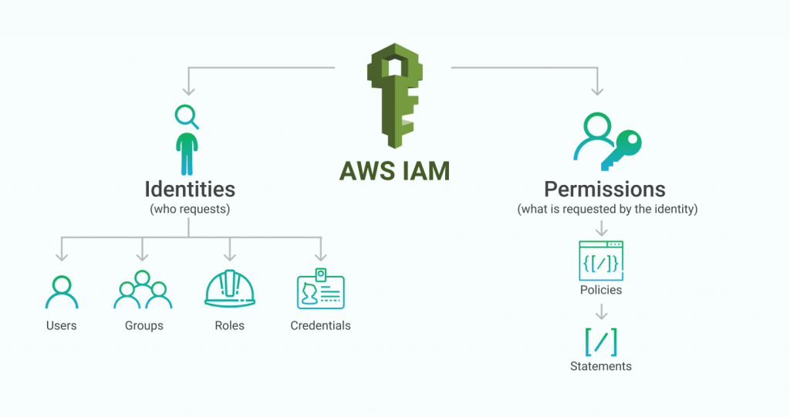
AWS IAM

Slide 4
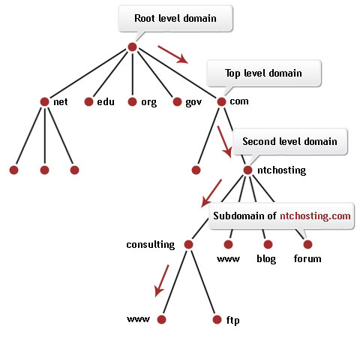
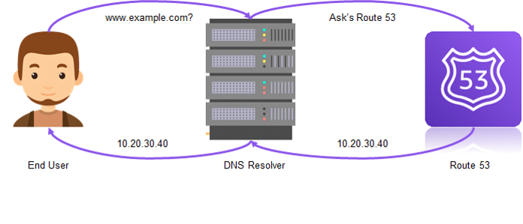
AWS Route-53

Slide 5
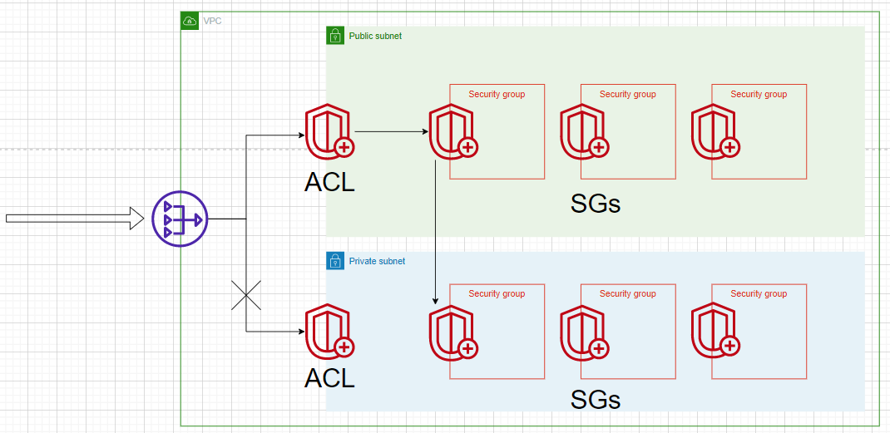
AWS network SECURITY

Slide 6
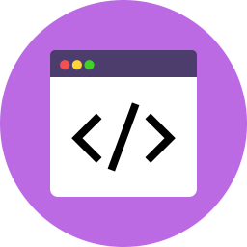
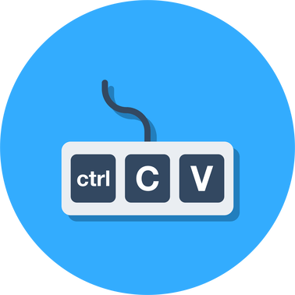
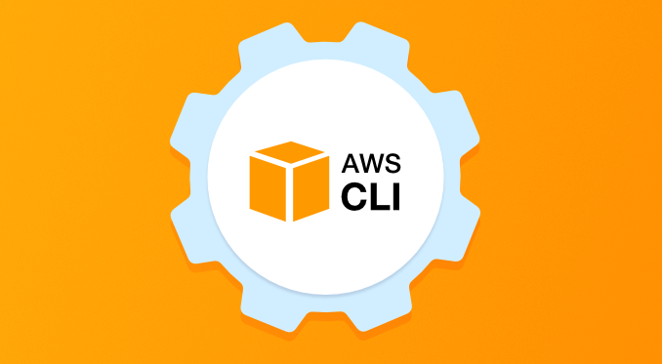
AWS CLI

Slide 7

Python

